Slide 1
Putting disabled and older people at the centre of eAccessibility
Helen Petrie
Human Computer Interaction Research Group
University of York

Slide 2
The overview
Some reflections on with disabled and older target users in multi-national, multi-disciplinary EU projects
I will name projects (but not names!) and be a bit critical, but I intend no disrespect, I know that everyone was doing the best they could
I’ll end with some new ideas about a positive approach to eAccessibility

Slide 3
GUIB Project
My first EU Project
No initial requirements work with users (that I remember, but I wasn’t in at the beginning)
I applied what I’d learnt in psychology to evaluations
One system developed tailored very much to the one blind person on the project team

Slide 4
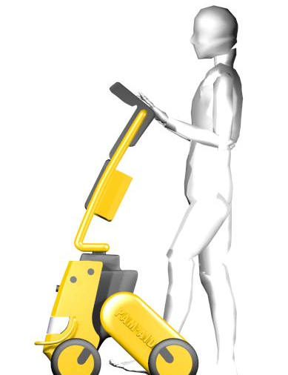
PAM-AID
Based on inspiration from relative of project leader
Completely mis-guided idea!
“you can talk to users?”
A project that really tried to listen to users, but we still had some disasters – prototypes that were far too hi-tech and heavy for users

Slide 5
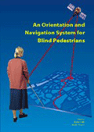
MoBIC
A project that began to get it right
In depth interviews with potential users, mobility officers
Numerous people in the project (including me) took mobility training
Numerous small evaluations and a large field trial

Slide 6
MultiReader
Another project that got it reasonably right (with Jan’s help)
Initial user requirements
incremental development, close attention to user requirements
A good prototype system

Slide 7
More recent projects
Is it getting any better? Are current EU projects working more deeply with users?
In these two slides I won’t name projects, as these are current or very recent projects
A project funded by the EU – to develop a very complex technology with no prior consultation with disabled users about whether they wanted it (answer was part of it no, part of it was technically impossible), no requirements phase and no-one in the project who knew anything about evaluation

Slide 8
Is it getting better?
A project where they had no idea how to do evaluations with users (and they got more money and have now asked me to plan their evaluations!)
And a project which is developing scenarios for future assistive technologies for older people with no consultation with users and no plans to validate the scenarios with users, the project is only consulting technology experts

Slide 9
We need to do better
We need to work more closely and deeply with our user groups
We can use various techniques such as contextual inquiry, scenario-based design and multi-variable evaluation need to be used much more
Projects need more expertise and education about working seriously with their target audiences

Slide 10
We need to do better in R&D
In the TIDE Initiative there was a reasonably sensible lifecycle that included eliciting requirements and doing evaluations, that seems to have been lost
There was also an expectation that a certain proportion of a project’s budget would be used on requirements and evaluation
Two excellent aspects of the TIDE Initiative seem to have been lost

Slide 11
The trouble is …
Doing all this is time-consuming and costs money
In the i2Web project we have done contextual inquiry with 14 web developers to better understand their work habits and how we would incorporate accessibility tools most effectively into their work
Interviews took 2 – 3 hours involved discussion, demonstration of work practices etc

Slide 12
i2Web Contextual inquiry
It is an excellent way of understanding people’s work practices
And it helps tease out some of the “socially appropriate” responses that people give in interviews or questionnaires
A number of surveys of web commissioners and web developers (several of which I was responsible for!) showed that 60 – 75% of websites are tested for accessibility
I never believed that

Slide 13
i2Web Contextual inquiry
When we did contextual interviews with web developers, a very different picture emerged, sometimes inadvertently
One developer said he used a particular accessibility tool, so was asked to demonstrate how he used it (a key part of contextual inquiry)
When he tried to open it, but the licence had run out months before
Other developers could not use the accessibility tools they said they used

Slide 14
i2Web contextual inquiry
But this comes at a cost:
Recruitment was difficult – web companies were suspicious of what we were doing
14 x 3 hours of interviews = 42 hours
At least 240 hours of analysis work

Slide 15
Pros and cons of European projects
European projects have many, many advantages
But I think in the assistive technology area there are several problems that have had an adverse effect on pushing developments through to market
In many cases (e.g. MoBIC, MultiReader) funding was not long enough to do user-centred design, for the developers to really understand the problem area of the users

Slide 16
Pros and cons of European Projects
The link between R&D work and commercialisation too weak
EU does provide “bridging” funding, but projects needed more support
And the international nature often worked against us – we could get commercialisation support in individual countries, but that would have broken up the consortium
In the case of MoBIC I think we lost an important opportunity for Europe to produce the first personal navigation aid and a far better one

Slide 17
A new approach to eAccessibility
Another line of thought about the way we approach accessibility conceptually rather than methodologically
Particularly when working on web accessibility, we conceptualize accessibility as a lack of accessibility problems
We assume that if we remove the barriers to access we will create something that disabled and older people will be able to use
But that assumes that the user is a passive consumer of information

Slide 18
A lack of problems?
But we know that isn’t true
All users of technology, disabled or non-disabled, are very active users of their technologies
We all have strategies, ways of interacting with technologies, trying to understand them
But we know very little about the strategies that different user groups use and how they interact with their functional limitations and the assistive technologies that they use

Slide 19
Users strategies
For example we know that blind web users often use a list of links to get an overview of a website – but who tells developers to look at the links on their page and see whether they act as a guide to what’s on the page?
So in the i2Web project we have just completed a large study of the strategies that 63 blind, partially sighted, deaf, hard of hearing, dyslexic, physically disabled and older people use with a range of types of websites and applications, with emphasis on “Web2.0”

Slide 20
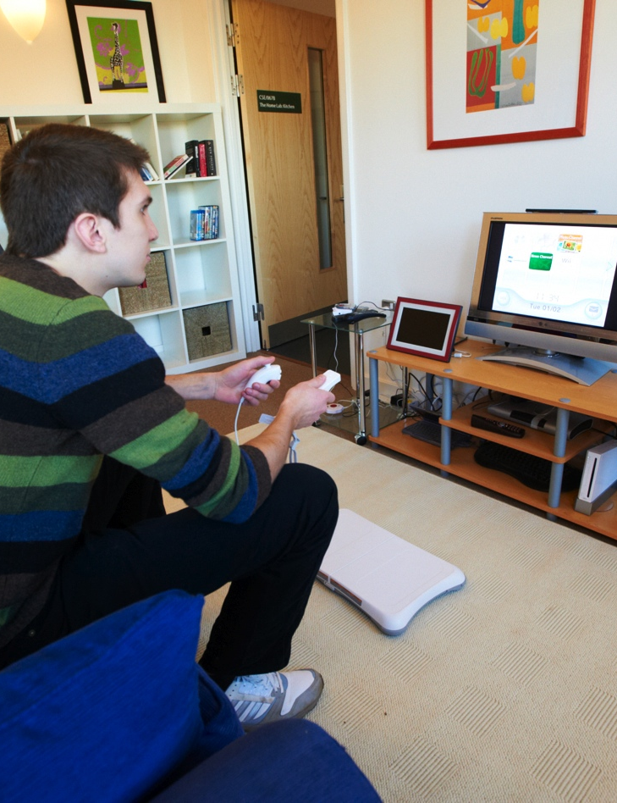
i2Web user strategy study
So far we have identified nearly 100 different strategies and analysis of the first 15 participants has found 489 instances of strategies
We have so many strategies that we have come up with a meta-analysis

Slide 21
Types of strategies
Navigation: The user applies a strategy to move from one web page or screen in an application to another
Discovery: The user applies a strategy to understand the structure of the web page or screen of information presented by the application
Exploration: The user applies a strategy to understand the information content of the web page or screen of information presented by the application
Anchoring: The user applies a strategy to reduce or limit the amount of information with which they are interacting

Slide 22
Conclusions
We still need better methodologies for working with users
We need to educate people about these methodologies
We need more positive approaches to eAccessibility, to build on people’s strategies as well as eliminating barriers

Slide 23
Conclusion
Jan Engelen is one of the people who inspired me to work in this area
He has inspired me again this week to go and write about elicitation and evaluation techniques for working with disabled and older people
I thank him for all his work and wish him a very happy retirement

