Slide 1
Department of
Electrical Engineering - ESAT
Mens- en maatschappij
gericht onderzoek in ESAT

Slide 2
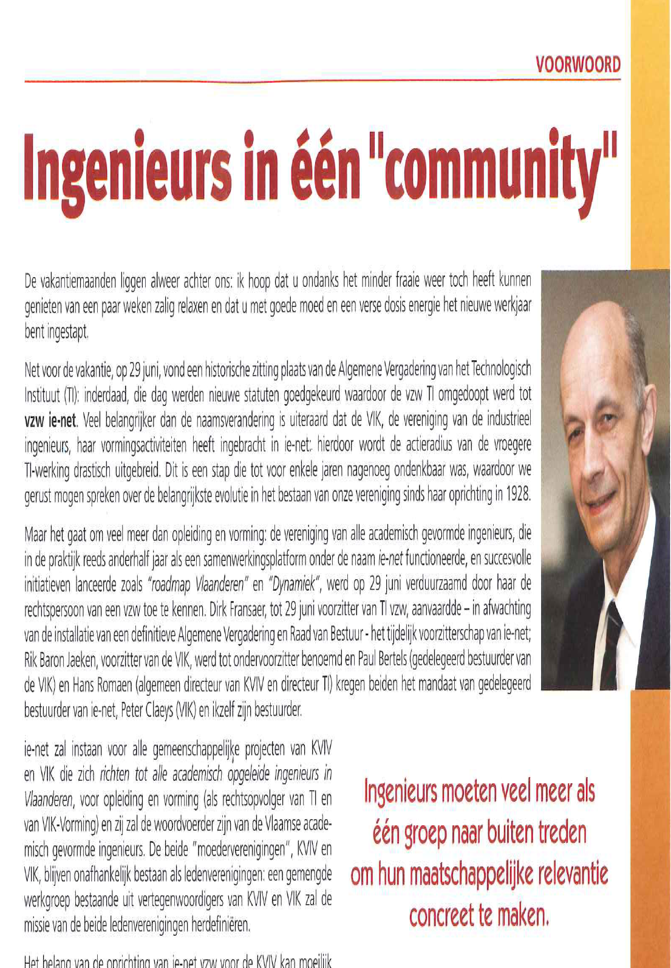

Slide 3

Research Cycle
Implementation
Measurements
EU FP6/FP7
Modelling
Simulation
Design

Slide 4























Department of Electrical Engineering - ESAT
Spin-Offs from ESAT
1.8/year #1

Slide 5
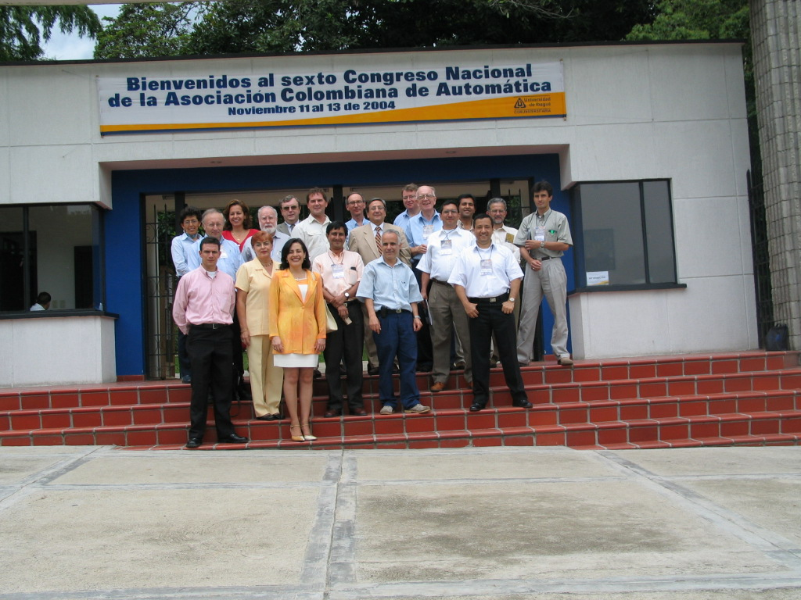
ESAT VLIR projecten ontwikkelingssamenwerking
Electa Anton de Kom Universiteit Paramaribo (Suriname
Elektrische energietechniek
SCD Coruniversitaria Universiteit Ibague, Colombië
automatizeringstechnieken

Slide 6

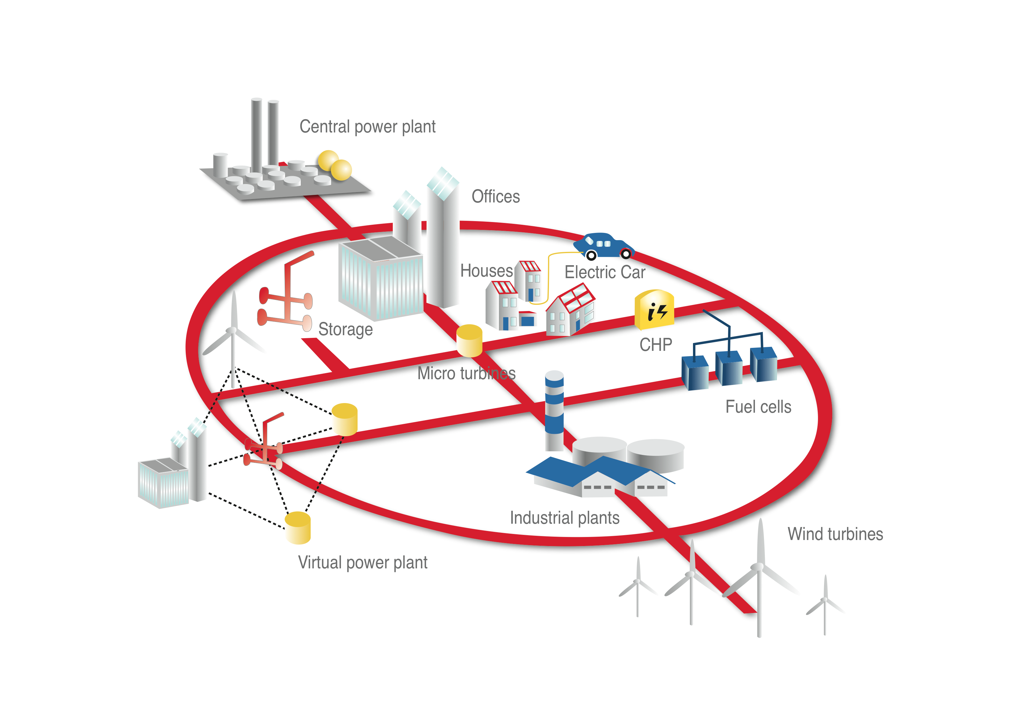

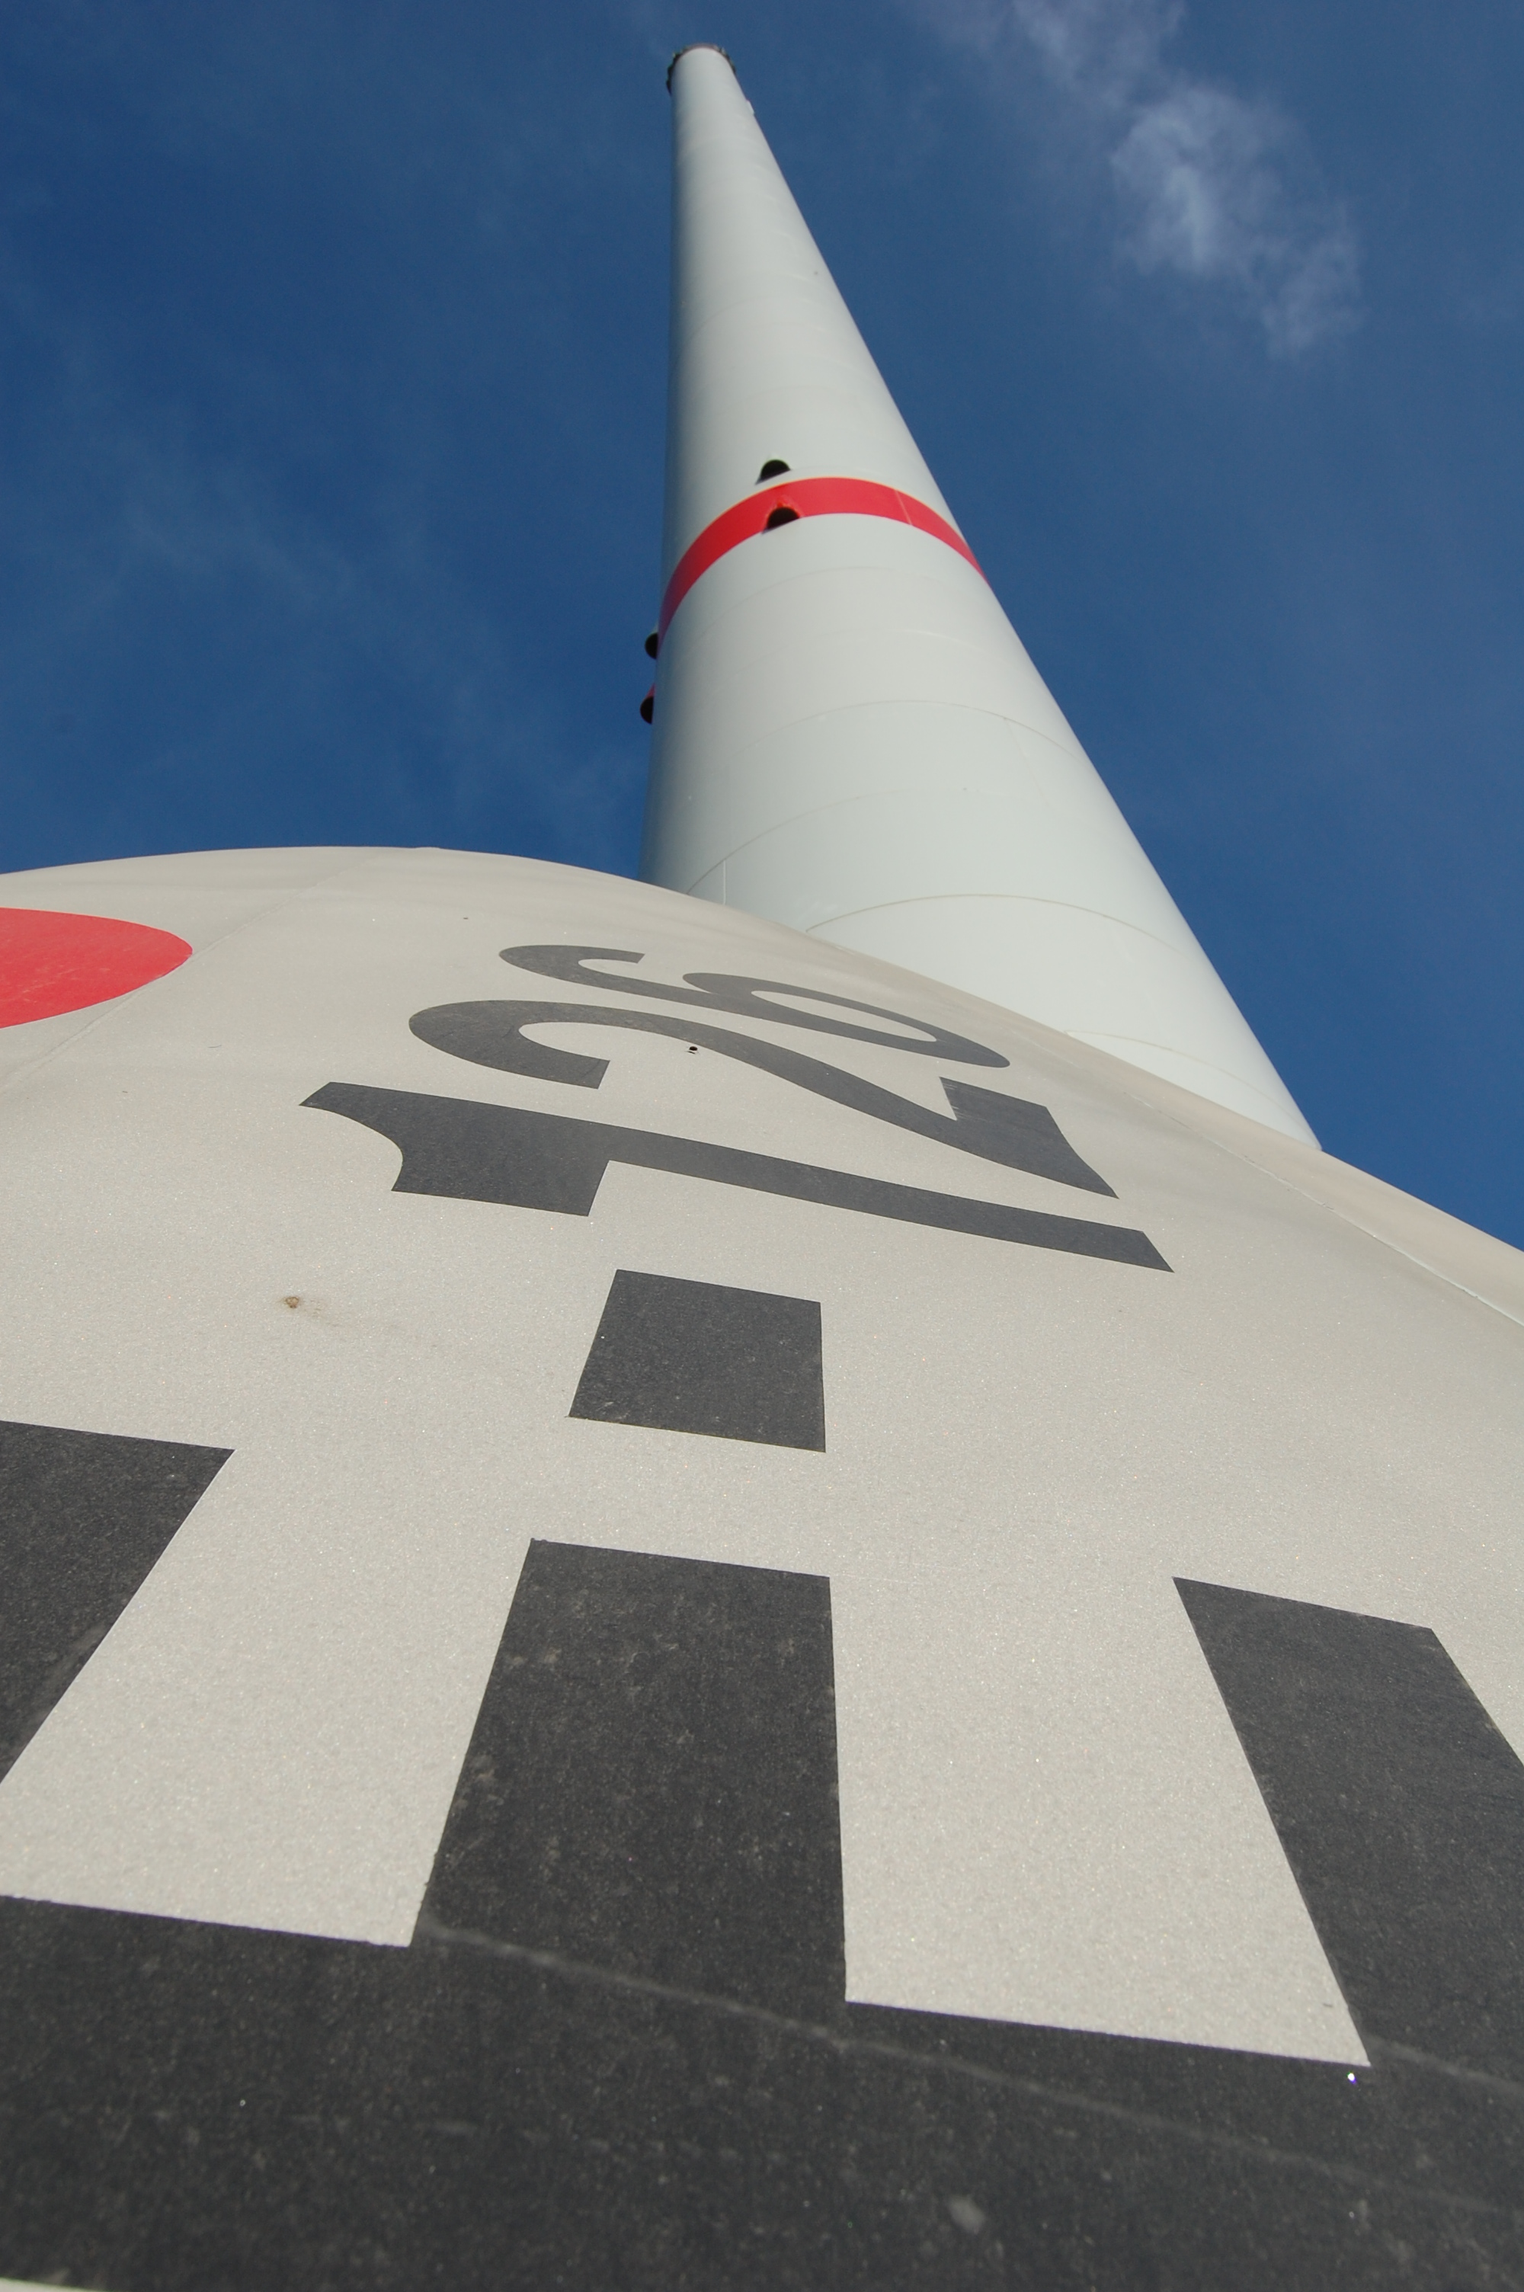
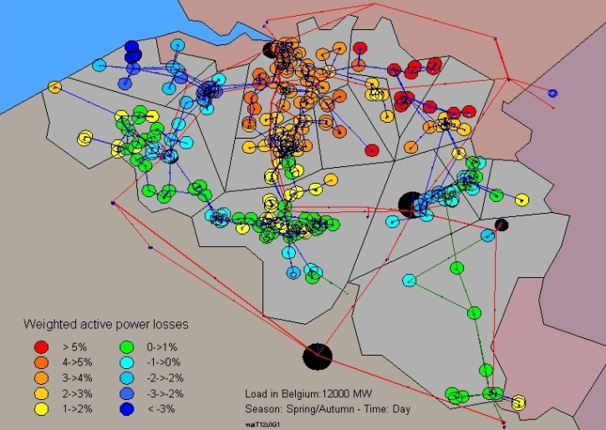
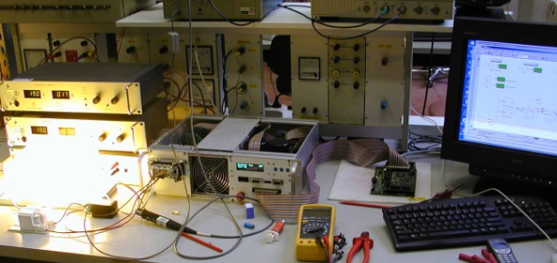
Electrical Energy & Computer Architectures
smart grids
distributed energy resources
power systems
energy-efficiency

Slide 7

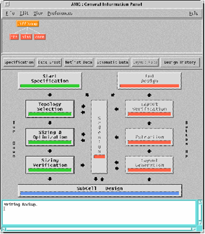
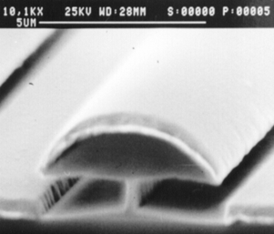
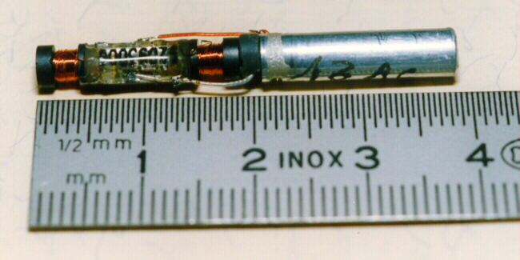
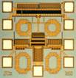
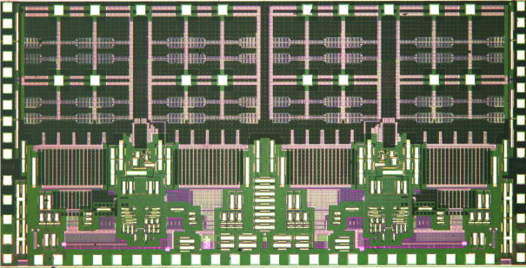
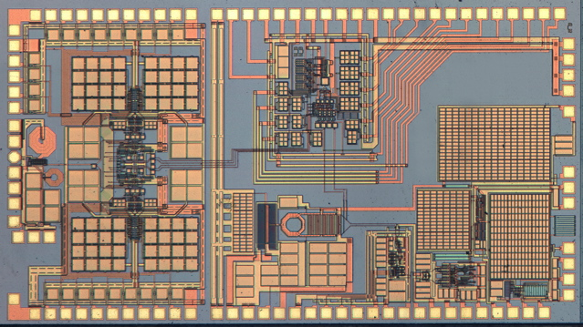
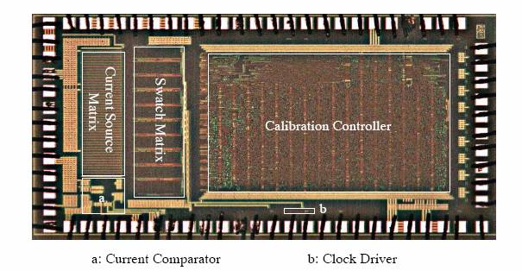
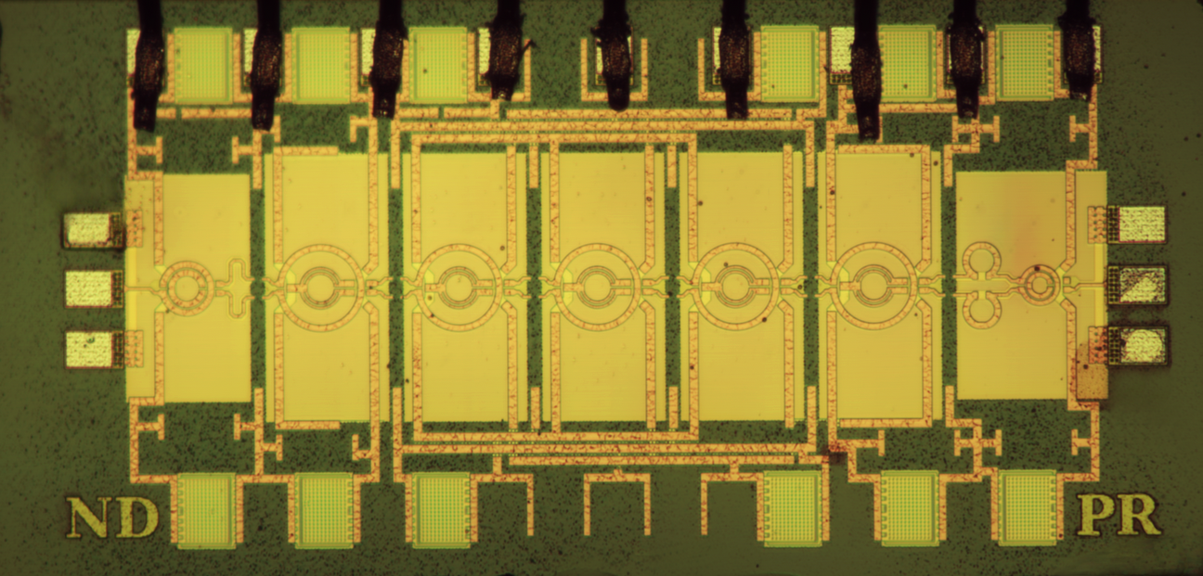
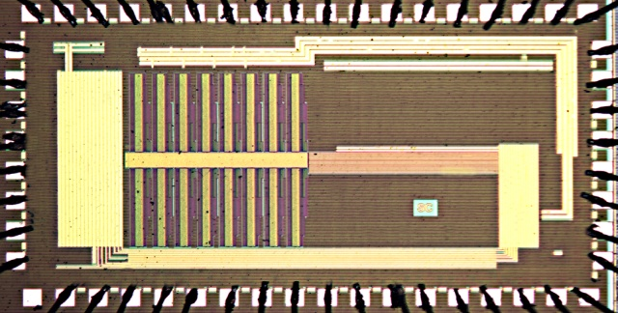
MICroelectronics And Sensors
Design and CAD for integrated circuits, systems, sensors and MEMS for telecommunications, multimedia, automotive, biomedical applications…
Wim Dehaene, Georges Gielen, Robert Puers, Patrick Reynaert, Michiel Steyaert
Analog/Digital
Design Methodologies
Sensor
Technologies
& Biomedical
Systems
Analog & Mixed-signal IC Design
mm-Wave
&
RF Circuits
Digital
IC Design

Slide 8

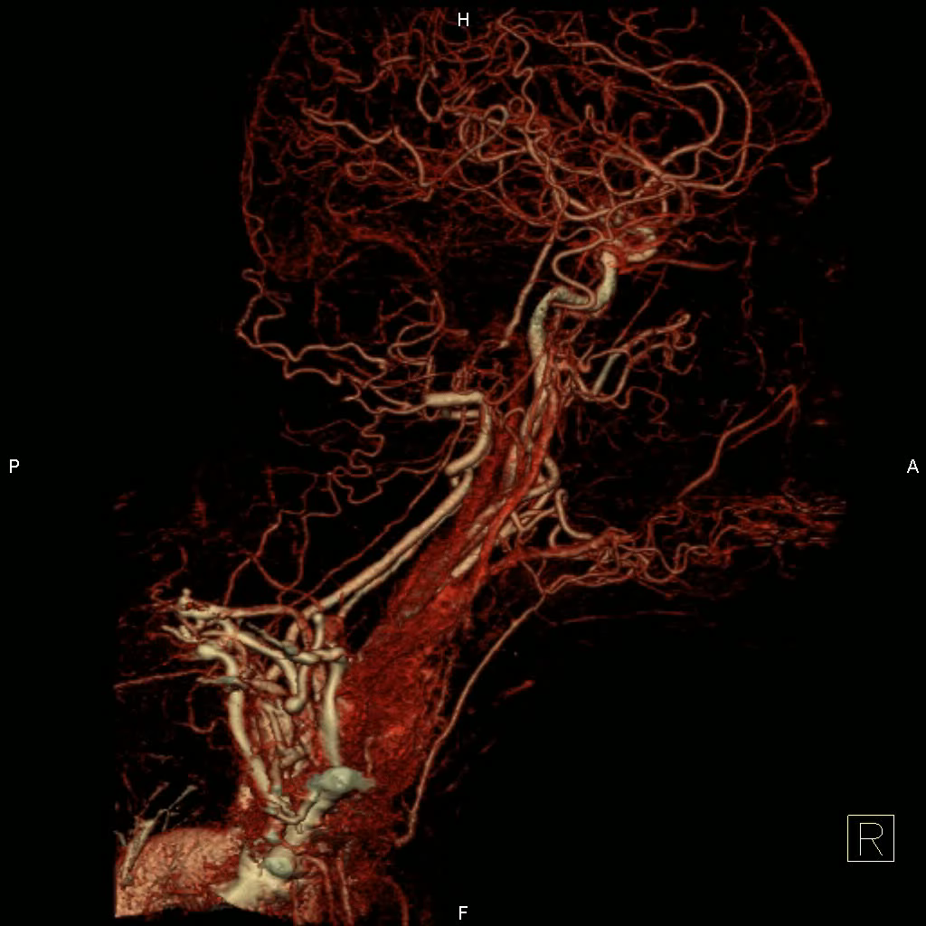
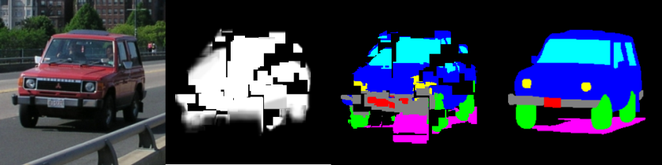
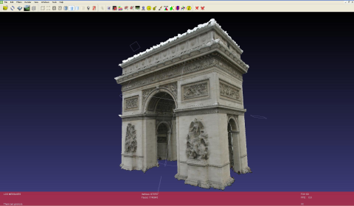
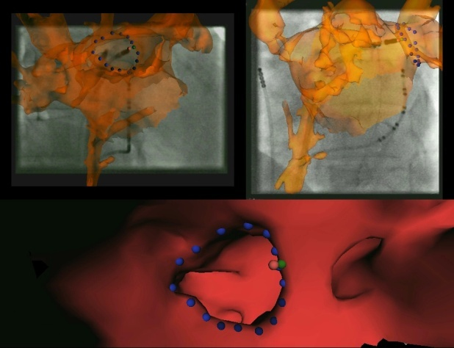
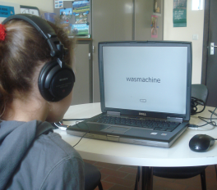
Center for Processing Speech and Images
Image and Speech Processing
Paul Suetens, Dirk Vandermeulen, Frederik Maes – Luc Van Gool, Luc Van Eycken, Tinne Tuytelaars –
Patrick Wambacq, Hugo Van hamme, Dirk Van Compernolle
3D Reconstruction/Object Recognition
Multimedia and Virtual Reality
Computer Aided Diagnosis
Image Guided Therapy & Surgery
Speech Representation
Speech Recognition
Notes:
8

Slide 9

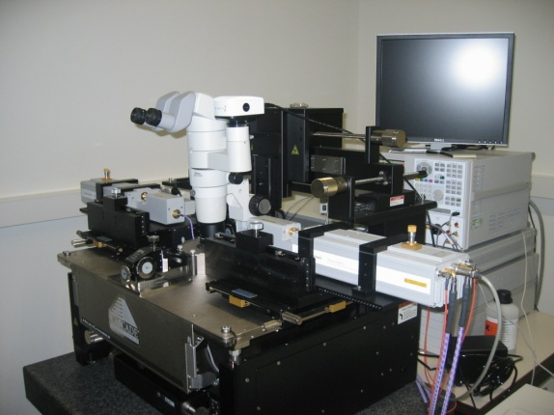
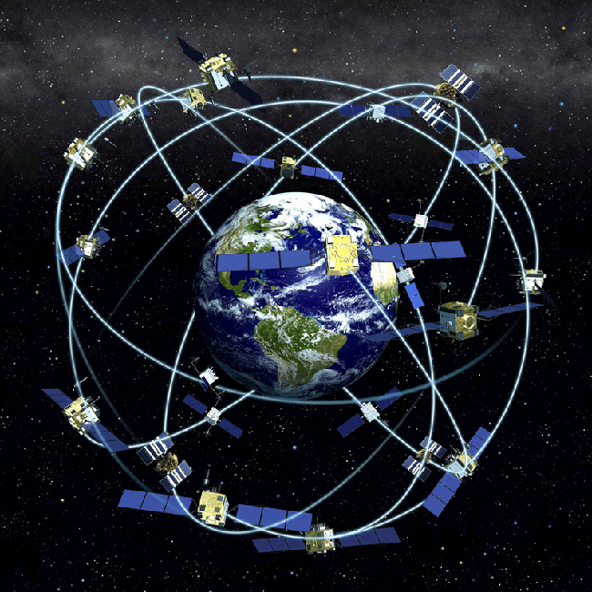
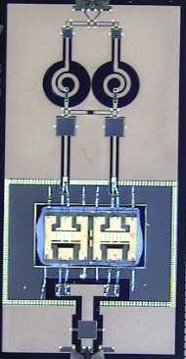
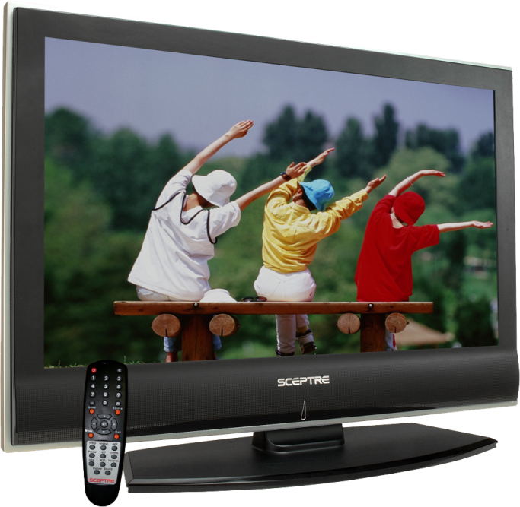
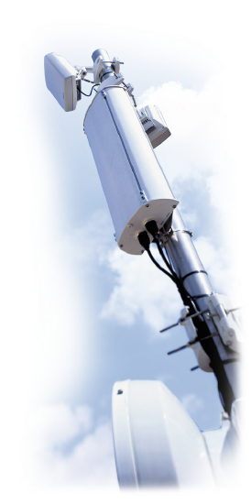
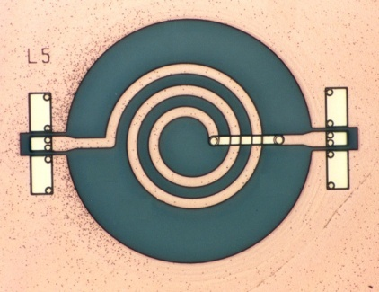


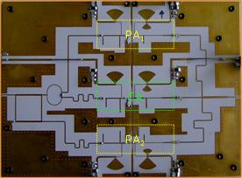

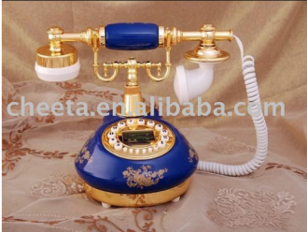
TELEcommunications and MICrowaves
High-frequency devices and telecommunication networks
Antoine Van de Capelle, Emmanuel Van Lil, Bart Nauwelaers,Guy Vandenbosch, Dominique Schreurs
HF Components and Circuits
Network Research
B_{2,carrier} [dBm]
f_{m} [Hz]

Slide 10

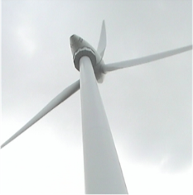
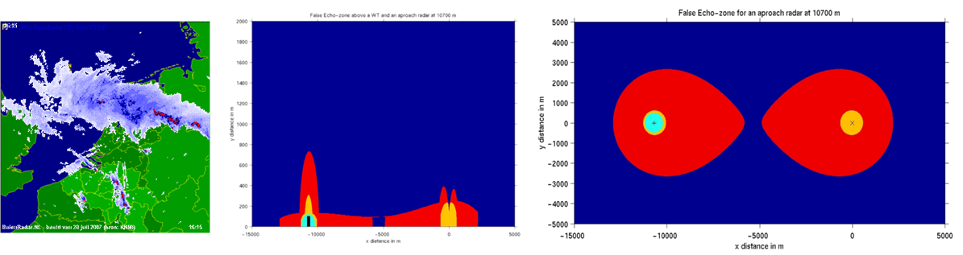
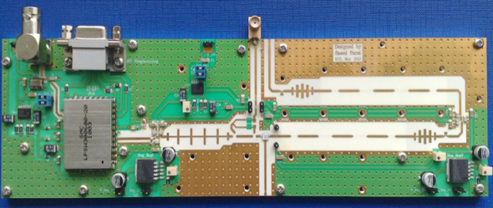
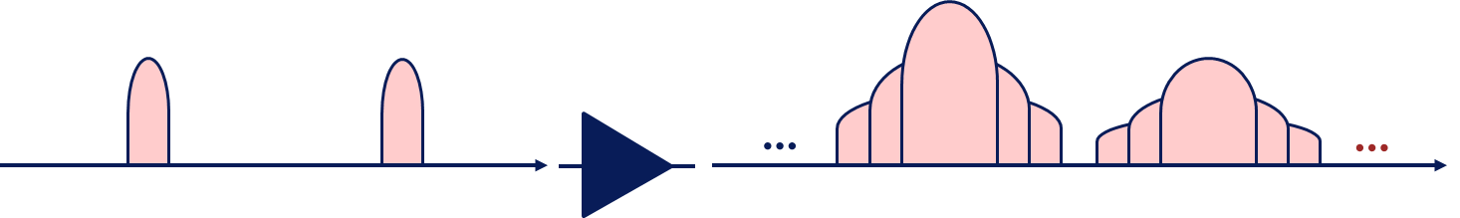
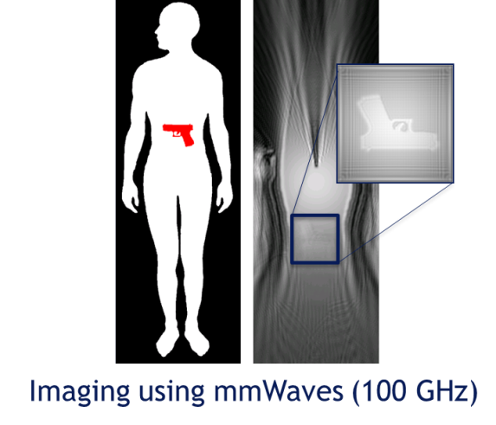
Success Stories
  Authority in public radiation debate,
  without funding!
  Guy Vandenbosch
  Standard procedure recommended by EUROCONTROL to assess potential effects of large moving objects on RF systems
  Large Signal Network Analyzer and its applications
  Bridging the gap between
  microwave and millimeter wave field
  and optical theories

Slide 11

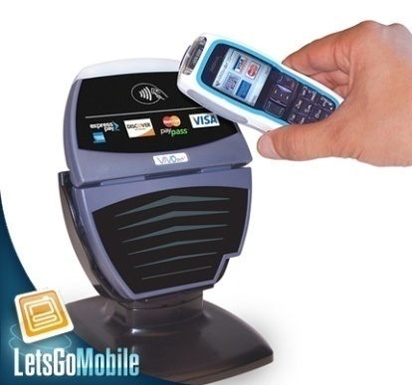
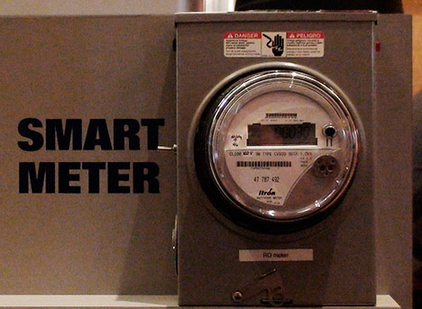
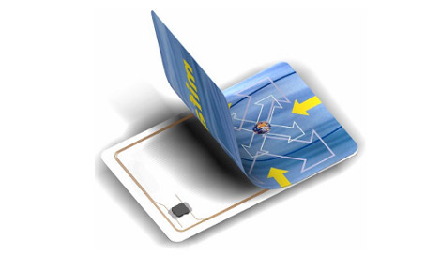
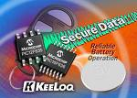
SISTA - COSIC - DOCARCH
Computer Security and Industrial Cryptography
Bart Preneel, Vincent Rijmen, Ingrid Verbauwhede, Claudia Diaz, Joos Vandewalle
Create the electronic equivalent of the real world: confidentiality, digital signature, privacy, anonymity, payments, DRM, elections, …
Applications:
  Telematics and logistics: car-to-car communications, remote entry, RFID
  Telecommunications: mobile and wireless
  Finance: e-payment, Near Field Communications (NFC)
  Health care:
  E-government: eID card, e-voting
  Energy: smart meters
  …

Slide 12
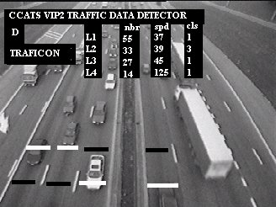
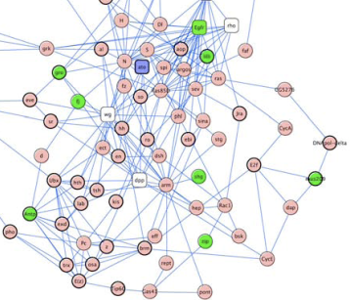

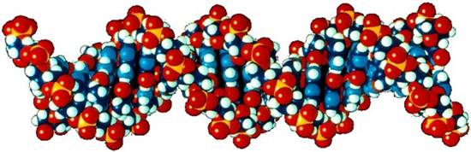
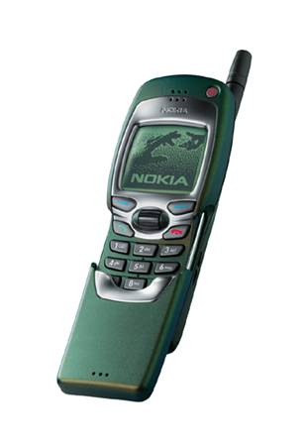
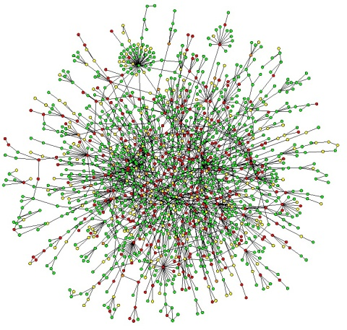

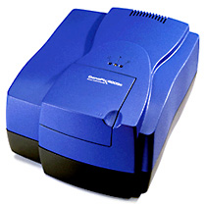
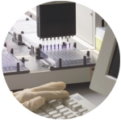
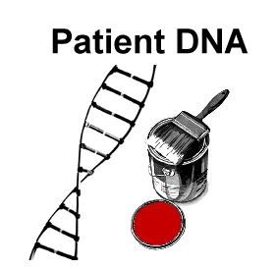

SISTA - COSIC - DOCARCH
Mathematical Engineering and Signal Processing
Joos Vandewalle, Bart De Moor, Yves Moreau, Marc Moonen, Johan Suykens, Moritz Diehl, Lieven
De Lathauwer, Sabine Van Huffel, Jan Engelen, Jan Aerts
System Identification & Control
Datamining & Information retrieval
Bioinformatics & Systems Medicine
Document Architectures

Slide 13
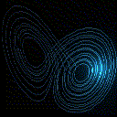
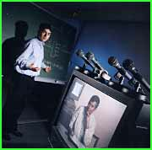
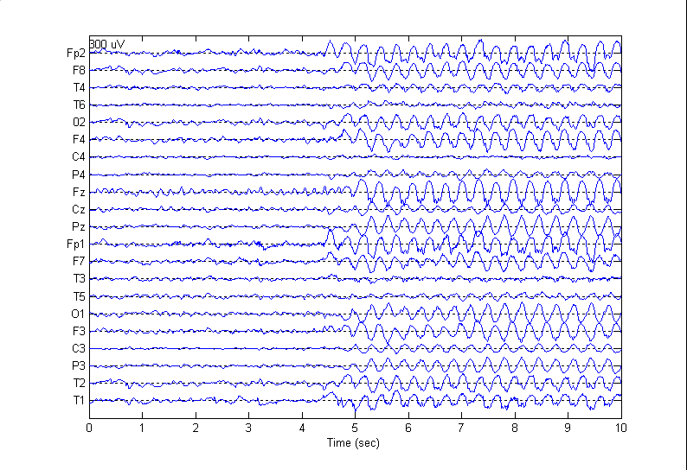
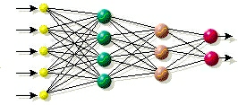
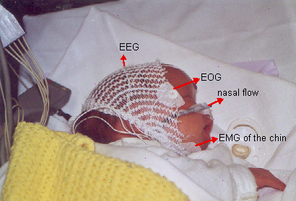


SISTA - COSIC - DOCARCH
Mathematical Engineering and Signal Processing
Joos Vandewalle, Bart De Moor, Yves Moreau, Marc Moonen, Johan Suykens, Moritz Diehl, Lieven
De Lathauwer, Sabine Van Huffel, Jan Engelen, Jan Aerts
Numerical Linear Algebra
Telecom/Audio Signal Processing
Nonlinear and Complex Systems
Biomedical Signal Processing

Slide 14

Success Stories AES
The success of the Advanced Encryption Standard remains unequalled.
designed by two COSIC cryptographers, Joan Daemen & Vincent Rijmen
Submitted as “Rijndael” to AES selection & standardization process
among 15 competing designs
National Institute of Standards and Technology (NIST)
as U.S. FIPS PUB 197 Nov. 26, 2001
AES is used in >10000 products (e.g. 3G phones, operating syst., web appl.)
by more than a billion users 10⁹ !!.
In 2010, Intel added AES instruction in Westmere architecture.
NYTimes TECHNOLOGY; U.S. Selects a New Encryption Technique October 03, 2000 a three-year worldwide search for a new encryption technique powerful enough to earn the official endorsement of the United States government, the Commerce Department named a winner: Rijndael. two Belgian computer scientists, Vincent Rijmen and Joan Daemen.
The fact that the standard emerged from a country known more for its chocolate than for its software shows the international nature of the cryptographic field.

Slide 15


SISTA - COSIC - DOCARCH
Document architectures
Jan Engelen, Sabine Van Huffel
international standards in the XML (Extensible Markup Language) XHTML, XSLT, MathML, multimedia standards HyTime and SMIL;
e-commerce developments such as ebXML [Electronic Business XML] and eBooks
document transformations from unstructured into structured formats
Building superstructures above electronic documents and navigation through these collections (Topic Maps concept) ;
production, use and handling of metadata enriched documents for data retrieval newspaper news item/articles
documents structured for reading impaired users legal texts
Docarch since 1992 23 EU projects - 6 as coordinator
INCLUSO seven European partners, FP 7
ICT for independent living and inclusion
Accessible and inclusive ICT,
proof of concept for ICT solutions for social inclusion of marginalized young people.

Slide 16


Bezoek Prinses Mathilde aan tentoonstelling wetenschapsweek
Smart-on-Tour tentoonstelling
9 november 2002

Slide 17

Het toeval
Europese projecten
leiden ons ongepland naar
Sevilla in hetzelfde restaurant op dezelfde avond
Beste Jan, Bedankt
voor jouw niet aflatende
inzet en zorg, en intense
gedrevenheid,
Je bent een levend voorbeeld van technologie
voor de mens
Beste Jan en Leni,
Het ga je goed

